Slide 1
SOLVING PROBLEMS BY SEARCHING
Nhân bản – Phụng sự – Khai phóng

Slide 2
Solving Problems By Searching
Search Problems
Uninformed Search
Informed Search

Slide 3
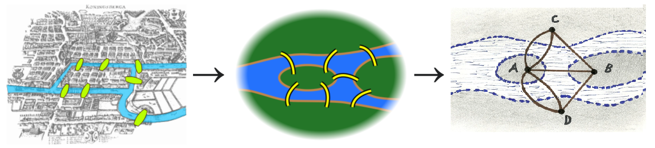
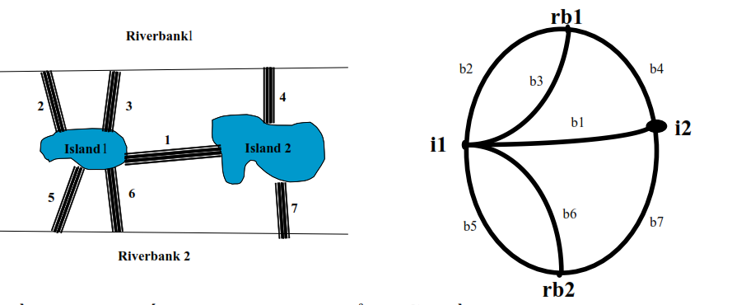
SOLVING PROBLEMS BY SEARCHING
The Seven Bridges of Königsberg Euler’s graphical representation

Slide 4
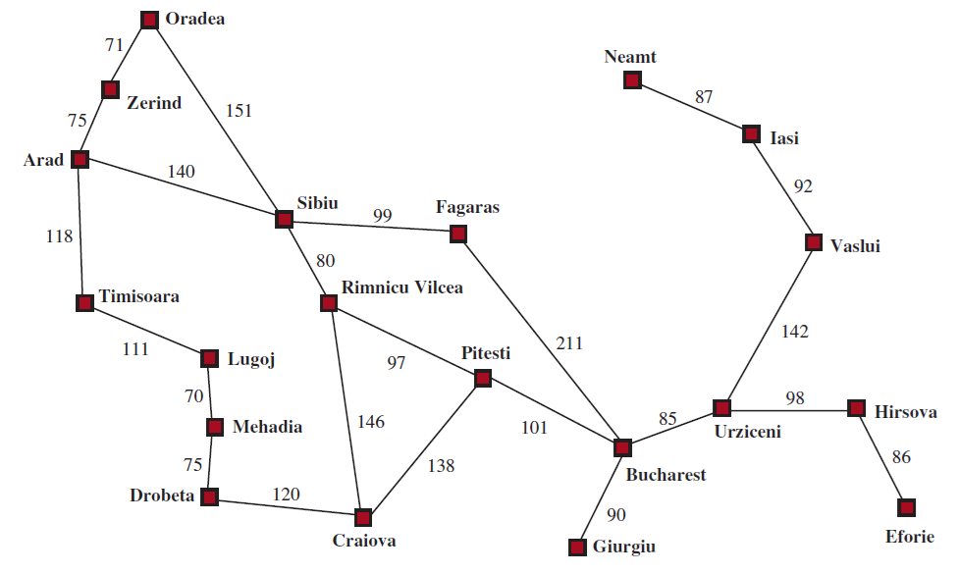
Problem-Solving Agents
Goal formulation:
  Goals organize behavior by limiting the objectives and hence the actions to be considered.
Problem formulation:
  The agent devises a description of the states and actions necessary to reach the goal-an abstract model of the relevant part of the world.
Search:
  Before taking any action in the real world, the agent simulates sequences of actions in its model, searching until it finds a sequence of actions that reaches the goal. Such a sequence is called a solution.
Execution:
  The agent can now execute the actions in the solution, one at a time.
A
Solution: a sequence of actions

Slide 5
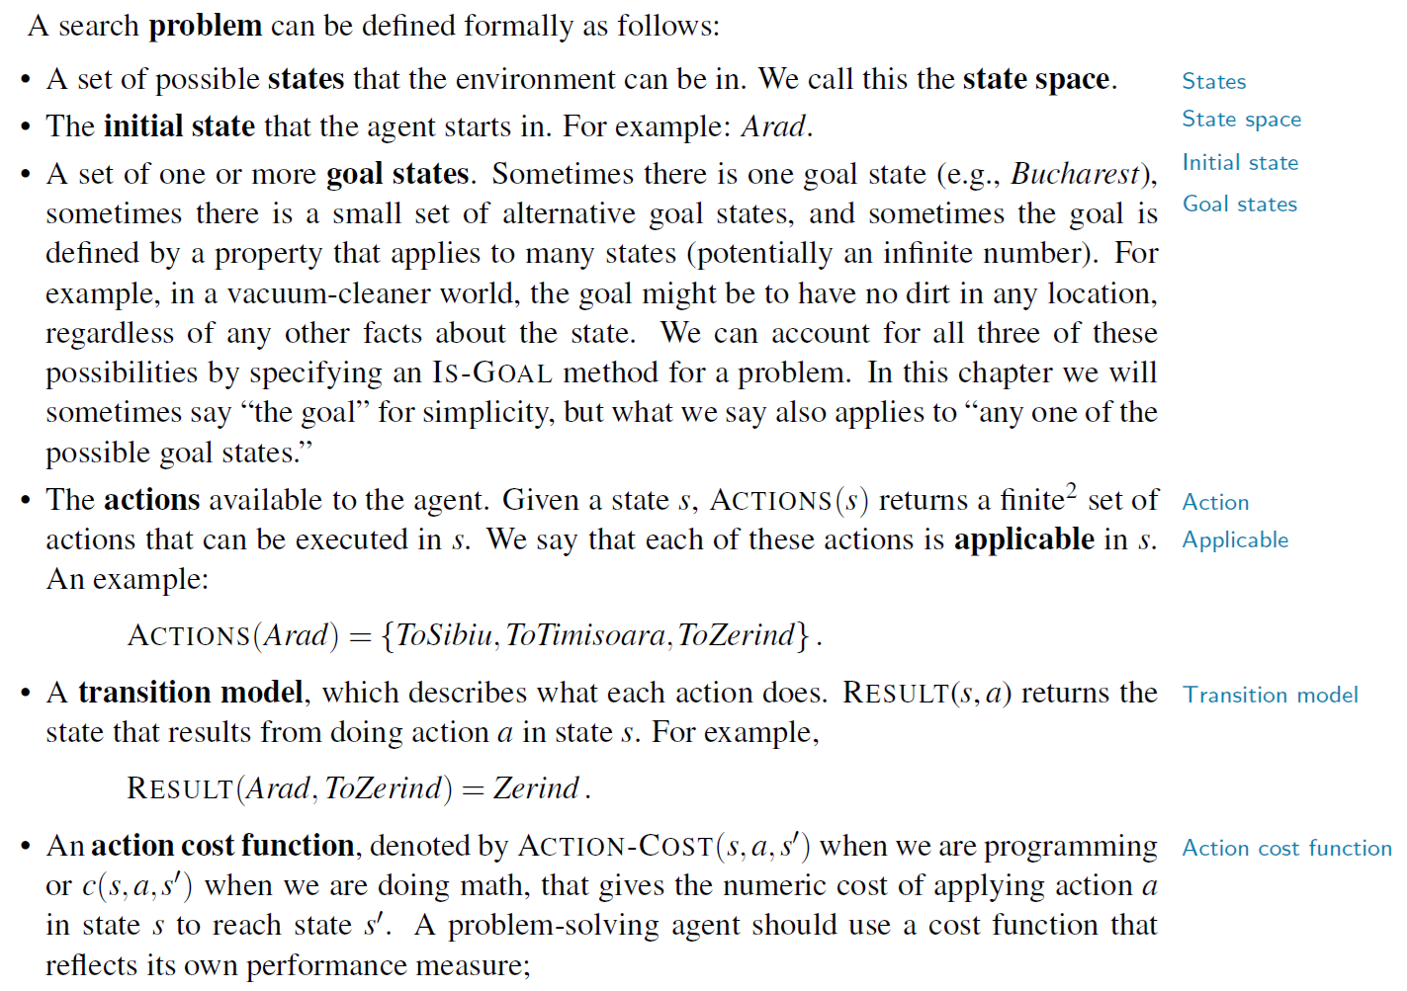
A sequence of actions forms a path, and a solution is a path from the initial state to a goal state.
We assume that action costs are additive; that is, the total cost of a path is the sum of the individual action costs.
An optimal solution has the lowest path cost among all solutions.

Slide 6
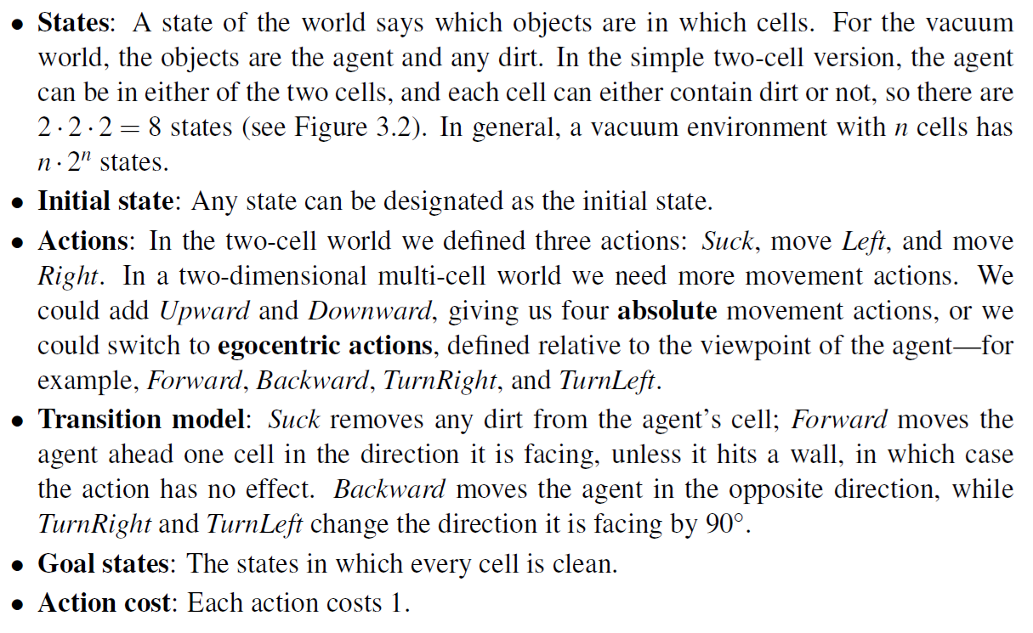
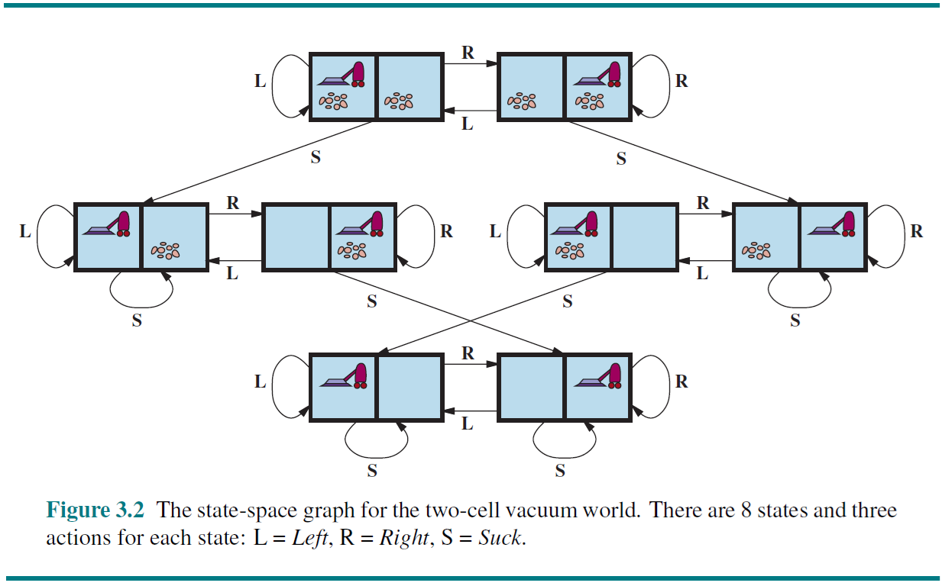
Search problem

Slide 7
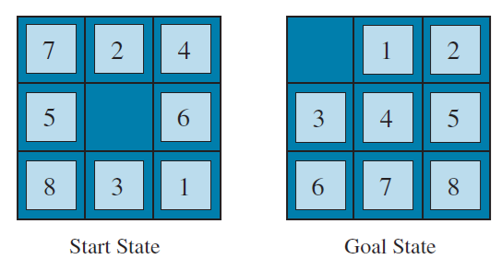
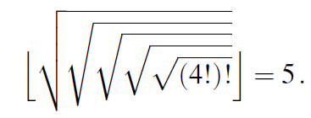
Search problem
The problem definition is simple:
  States: Positive real numbers
  Initial state: 4
  Actions: Apply square root, floor, or factorial operation (factorial for integers only)
  Transition model: As given by the mathematical definitions of the operations
  Goal state: The desired positive integer.
  Action cost: Each action costs 1
The standard formulation of the 8 puzzle is as follows:
  States: A state description specifies the location of each of the tiles
  Initial state: Any state can be designated as the initial state
  Actions: While in the physical world it is a tile that slides, the simplest way of describing an action is to think of the blank space moving Left, Right, Up, or Down. If the blank is at an edge or corner then not all actions will be applicable
  Transition model: Maps a state and action to a resulting state
  Goal state: Although any state could be the goal, we typically specify a state with the numbers in order
  Action cost: Each action costs 1

Slide 8
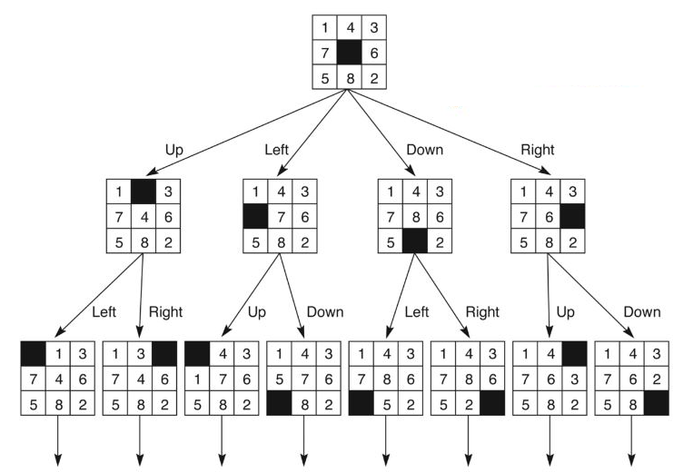
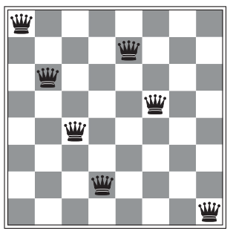
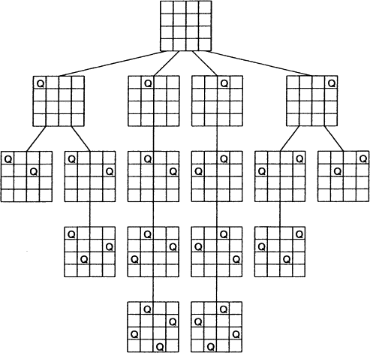

Search problem

Slide 9
Search Data Structures
Search algorithms require data structures to keep track of the search tree
A node in the search tree is represented by four components:
  node.STATE: the state to which the node corresponds
  node.PARENT: the node in the tree that generated this node
  node.ACTION: the action applied to the parent’s state to generate this node
  node.PATH-COST: the total cost of the path from the initial state to this node
  g(n)=PATH-COST
Following the PARENT pointers from a node allows us to recover the states and actions along the path. From a goal node, this gives us the solution

Slide 10
Search Data Structures
The frontier stores nodes that have been generated but not yet expanded
A queue is used to store the frontier
Main operations:
  IS-EMPTY(frontier): returns true if there are no nodes in the frontier
  POP(frontier): removes and returns the top node
  TOP(frontier): returns, but does not remove, the top node
  ADD(node, frontier): inserts a node into its proper place in the queue
Key idea: The way nodes are organized and selected from the frontier determines the search strategy.

Slide 11
Search Data Structures
Three kinds of queues are commonly used in search algorithms:
  Priority Queue
    Pops the node with the minimum cost according to an evaluation function f
    Used in best-first search
  FIFO Queue:
    Pops the node that was added first
    Used in breadth-first search
  LIFO Queue:
    Pops the most recently added node
    Used in depth-first search

Slide 12
State Space Graph and Search Tree
State Space Graph: A state space graph shows all possible states of a problem.
  Each node is a state.
  Each edge is an action.
  It shows how states are connected.
  It may have cycles.
  A state appears only once in the graph.
Search Tree: A search tree is created by a search algorithm.
  The root is the initial state.
  Children are states generated from actions.
  It is always a tree (no cycles).
  The same state may appear many times.
  Each node stores extra information:
    state
    parent
    action
    path cost
Important:
  A search node is NOT the same as a state
  A node contains a state plus extra information.

Slide 13
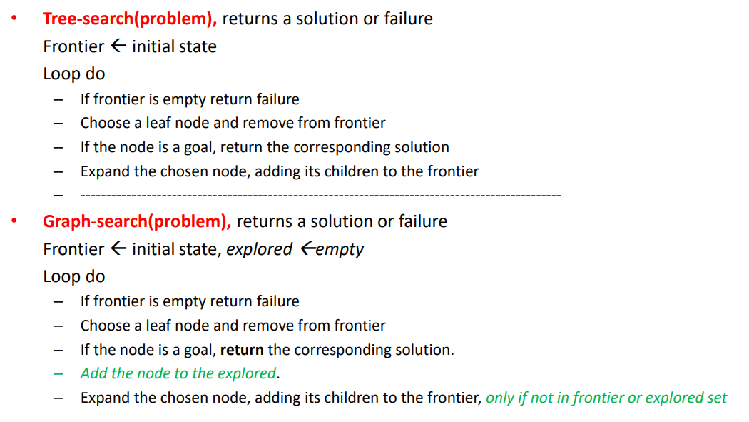
Tree-search and Graph Search

Slide 14
Search Trees
State Space Graphs vs. Search Trees
State Space Graph
Search Tree
Each NODE in in the search tree is an entire PATH in the state space graph.
S
a
G
d
e
p
b
c
q
b
c
e
h
r
d
e
f
a
a
h
r
p
q
f
S
h
We construct both on demand – and we construct as little as possible.
p
q
f
q
c
G
p
q
r
q
c
G
a
a

Slide 15
Search Trees
Example
a
G
b
c
e
d
e
d
f
f
S
h
p
r
q
r
S
s
s 🡪 d
s 🡪 e
s 🡪 p
s 🡪 d 🡪 b
s 🡪 d 🡪 c
s 🡪 d 🡪 e
s 🡪 d 🡪 e 🡪 h
s 🡪 d 🡪 e 🡪 r
s 🡪 d 🡪 e 🡪 r 🡪 f
s 🡪 d 🡪 e 🡪 r 🡪 f 🡪 c
s 🡪 d 🡪 e 🡪 r 🡪 f 🡪 G
d
e
p
b
c
e
h
r
q
a
a
h
r
p
q
f
p
q
f
q
c
G
q
c
G
a
a

Slide 16
Uninformed search
Depth-First Search
Breadth-First Search
Iterative-Deepening Search
Uniform-Cost Search

Slide 17
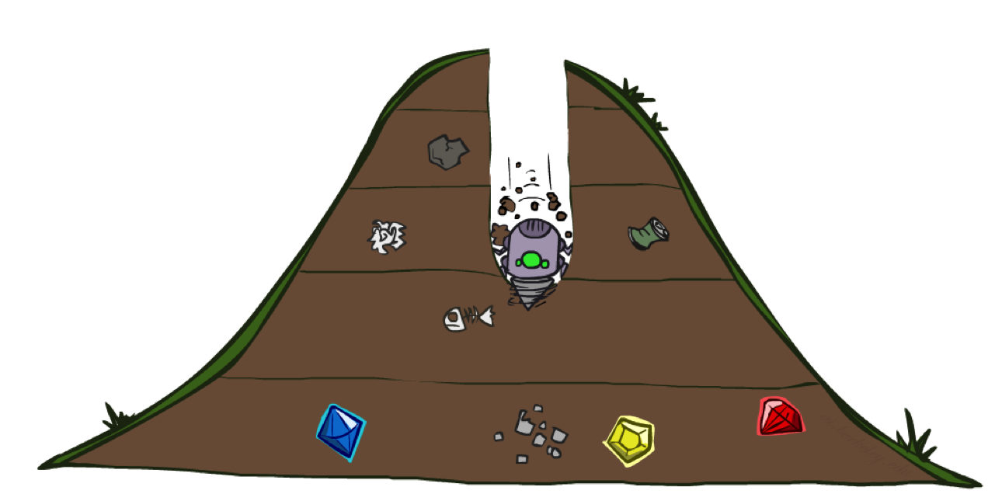
Depth-First Search (DFS)
Strategy: expand a deepest node first
Implementation: Fringe is a LIFO stack

Slide 18
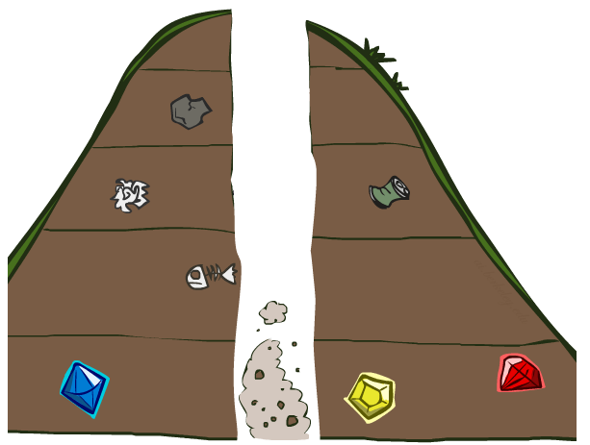
Depth-First Search (DFS)
a
G
a
c
b
c
b
e
d
e
d
f
f
S
h
h
p
p
r
q
r
q
S
d
e
p
b
c
e
h
r
q
a
a
h
r
p
q
f
p
q
f
q
c
G
q
c
G
a
a

Slide 19
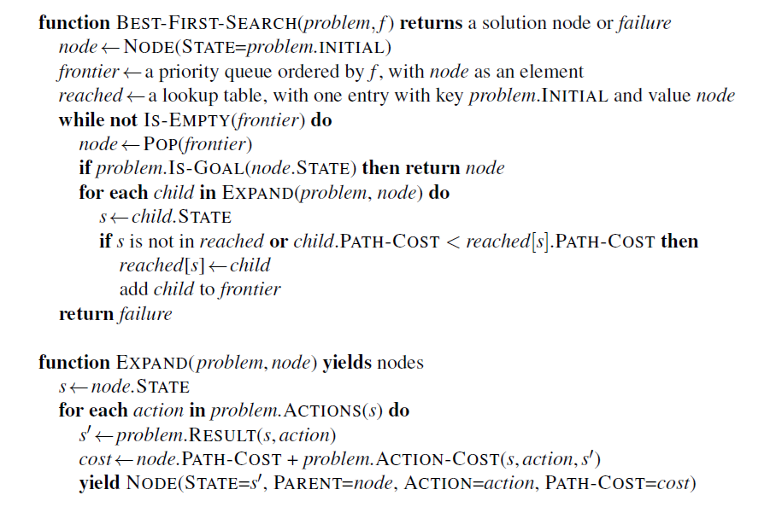
Depth-First Search (DFS)

Slide 20
Depth-First Search (DFS)
Properties
What nodes DFS expand?
  Some left prefix of the tree.
  Could process the whole tree!
Time: If m is finite, takes time O(b^{m})
Space: Only has siblings on path to root, so O(bm)
complete?
  m could be infinite, so only if we prevent cycles (more later)
optimal?
  No, it finds the “leftmost” solution, regardless of depth or cost
1 node
b
…
b nodes
b² nodes
m tiers
b^{m} nodes

Slide 21
Depth-First Search (DFS)
Properties
Complete: Guaranteed to find a solution if one exists?
Optimal: Guaranteed to find the least cost path?
Time complexity?
Space complexity?
Cartoon of search tree:
  b is the branching factor
  m is the maximum depth
  solutions at various depths
Number of nodes in entire tree?
  1 + b + b² + …. b^{m} = O(b^{m})
b
1 node
…
b nodes
b² nodes
m tiers
b^{m} nodes

Slide 22
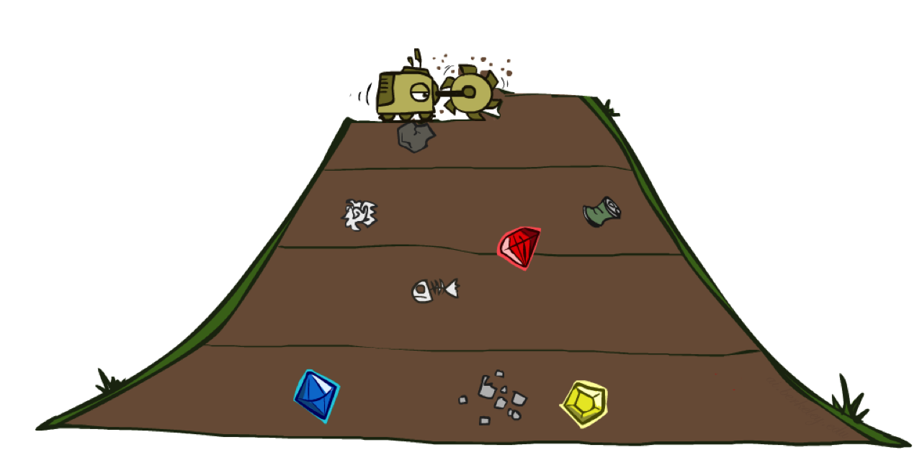
Breadth-First Search (BFS)
Strategy: expand a shallowest node first
Implementation: Fringe is a FIFO queue

Slide 23
Breadth-First Search (BFS)
a
G
b
c
d
e
f
S
h
p
q
r
S
d
e
p
Search
Tiers
b
c
e
h
r
q
a
a
h
r
p
q
f
p
q
f
q
c
G
q
c
G
a
a

Slide 24
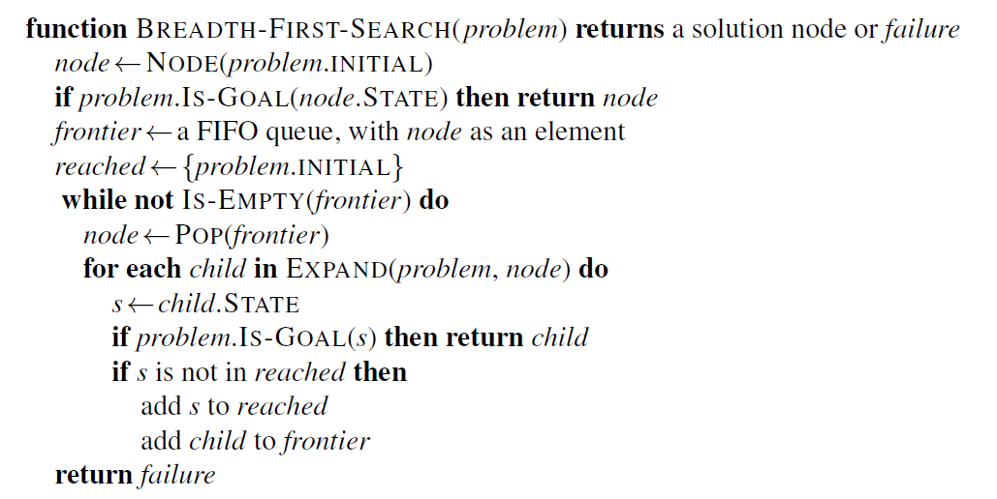
Breadth-First Search (BFS)

Slide 25
Breadth-First Search (BFS)
Properties
What nodes does BFS expand?
  Processes all nodes above shallowest solution
  Let depth of shallowest solution be s
Time: takes time O(b^{s})
Space: has roughly the last tier, so O(b^{s})
complete?
  s must be finite if a solution exists, so yes!
optimal?
  Only if costs are all 1 (more on costs later)
1 node
b
…
b nodes
s tiers
b² nodes
b^{s} nodes
b^{m} nodes

Slide 26
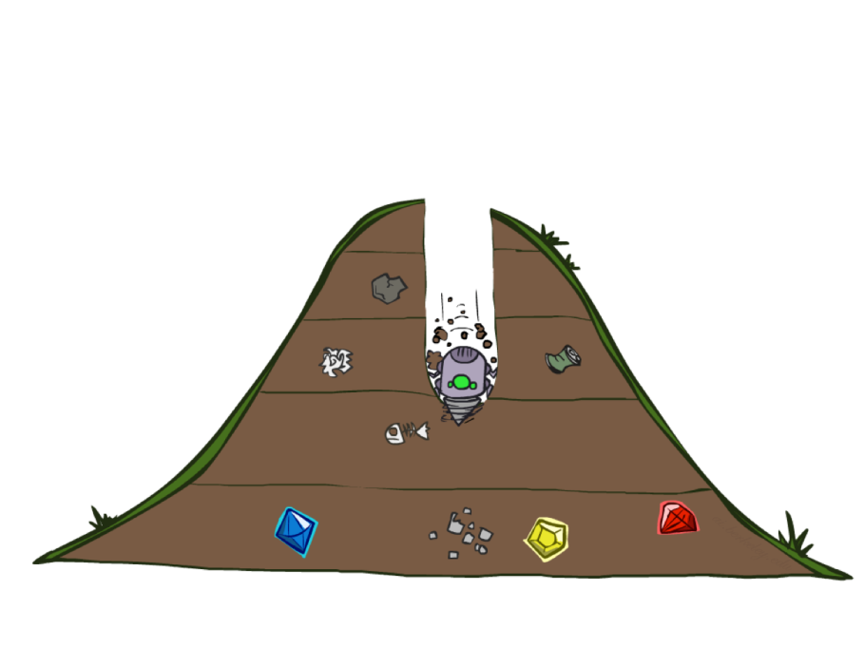
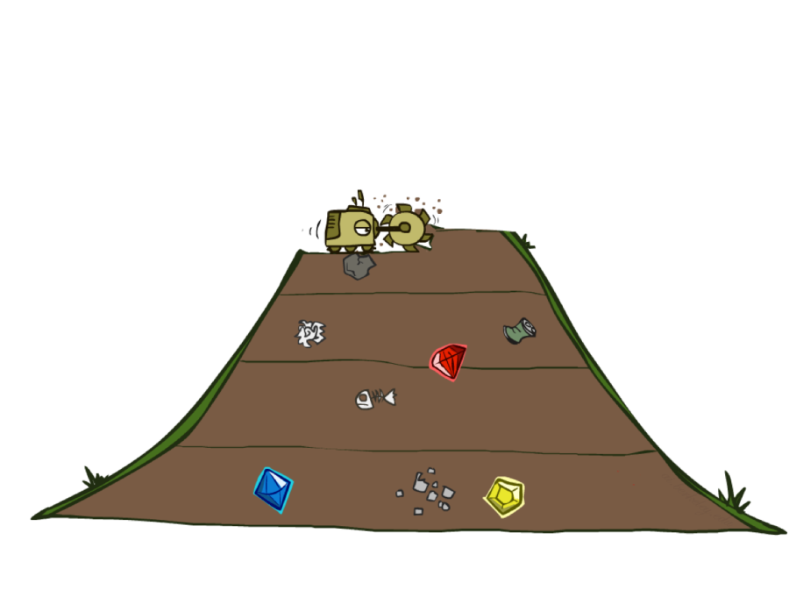
DFS vs BFS
DFS: need to get to the bottom. Memory constrained.
BFS: solutions not too far down.

Slide 27
Iterative-Deepening Search (IDS)
Idea: get DFS’s space advantage with BFS’s time / shallow-solution advantages
  Run a DFS with depth limit 1. If no solution…
  Run a DFS with depth limit 2. If no solution…
  Run a DFS with depth limit 3. …..
Isn’t that wastefully redundant?
  Generally most work happens in the lowest level searched, so not so bad!
b
…
Notes:
Vấn đề với giải thuật tìm kiếm với giới hạn độ sâu (DLS)
Nếu tất cả các lời giải (các nút đích) nằm ở độ sâu lớn hơn giới hạn độ sâu l, thì giải thuật DLS thất bại (không tìm được lời giải)
Giải thuật tìm kiếm sâu dần
Áp dụng giải thuật DFS với các đường đi (trong cây) có độ dài <=1
Nếu thất bại (không tìm được lời giải), tiếp tục áp dụng giải thuật DFS đối với các đường đi có độ dài <=2
Nếu thất bại (không tìm được lời giải), tiếp tục áp dụng giải thuật DFS đối với các đường đi có độ dài <=3
…tiếp tục như trên, cho đến khi: (1) tìm được lời giải, hoặc (2) toàn bộ cây đã được xét mà không tìm được lời giải

Slide 28
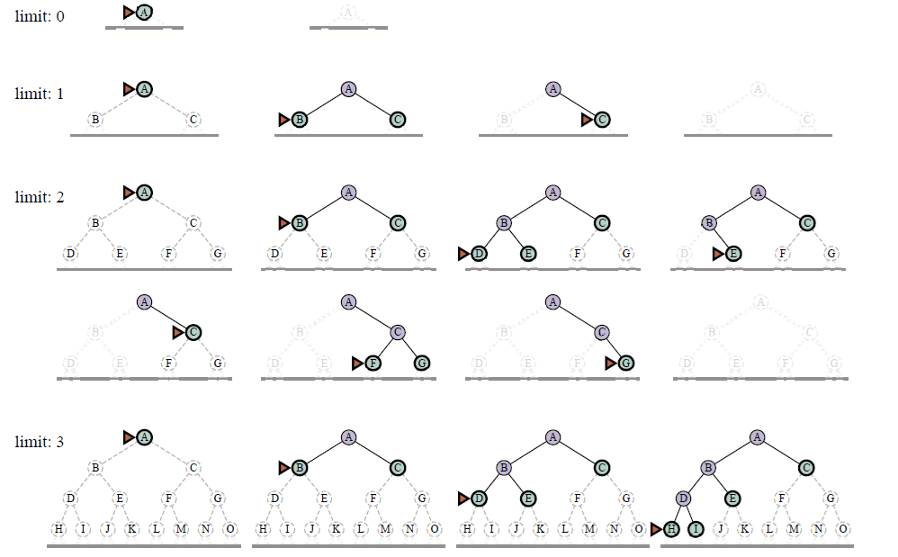
Iterative-Deepening Search (IDS)

Slide 29
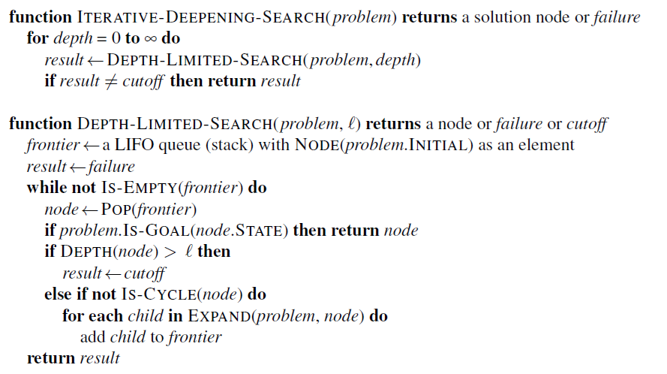
Iterative-Deepening Search (IDS)

Slide 30
Iterative-Deepening Search (IDS)
Properties
Complete
  Có
Time:
  (d+1).b⁰ + d.b¹ + (d-1).b²+ … +b^{d} = O(b^{d})
Space:
  O(b.d)
Optimal ?

Slide 31
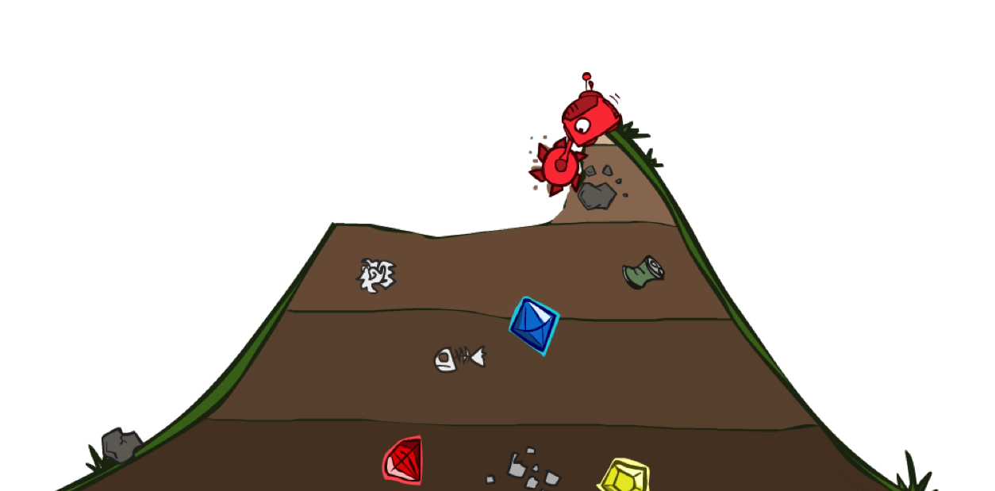
Uniform Cost Search(UCS)
Strategy: expand a cheapest node first:
Fringe is a priority queue (priority: cumulative cost)

Slide 32
Uniform Cost Search(UCS)
2
G
a
b
8
c
1
2
2
e
3
d
f
9
2
S
h
8
1
1
p
q
r
15
0
S
d
3
e
9
p
1
b
4
e
5
h
17
r
11
q
16
c
11
Cost contours
a
6
a
h
13
r
7
p
q
f
p
q
f
8
q
c
G
q
c
a
11
G
10
Contours show equal cost.
a
Notes:
Like breadth first, but with costs. Label with cumulative cost.
Goal path not victory until try to expanded.
Contours show equal cost.

Slide 33
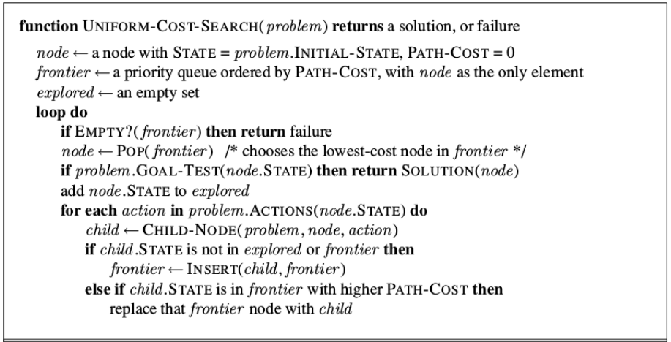
Uniform Cost Search(UCS)

Slide 34
Uniform Cost Search(UCS)
Properties
What nodes does UCS expand?
  Processes all nodes with cost less than cheapest solution!
  If that solution costs C* and arcs cost at least ε , then the “effective depth”
  is roughly C*/ε
Time: O(b^{C*/ε}) (exponential in effective depth)
Space: has roughly the last tier, so O(b^{C*/ε})
complete?
  Assuming best solution has a finite cost
  and minimum arc cost is positive, yes!
optimal?
  Yes! (Proof next lecture via A*)
b
c ≤ 1
…
C*/ε “tiers”
c ≤ 2
c ≤ 3

Slide 35
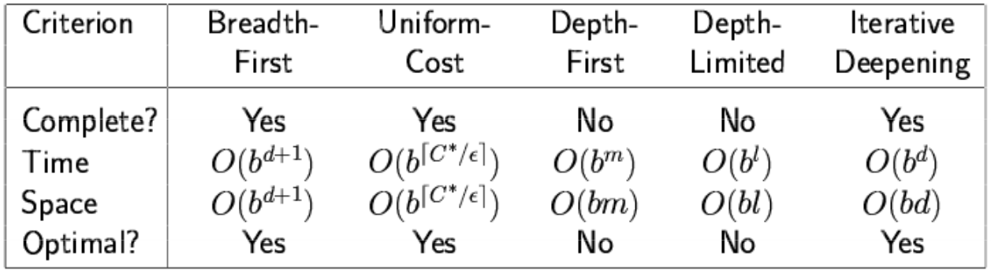
Uninformed Search

Slide 36
Informed search (Heuristic search)
Heuristic Function
Greedy Best-First Search
A* Search

Slide 37
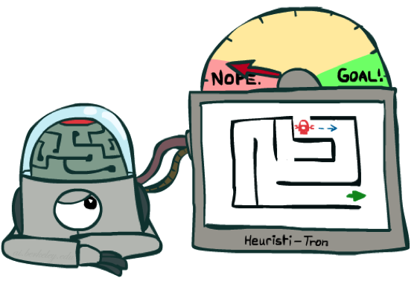
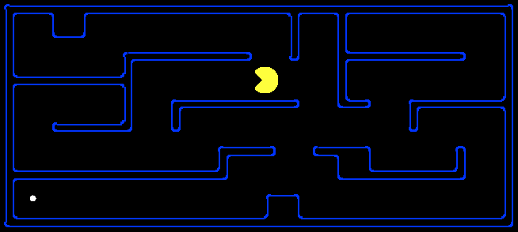
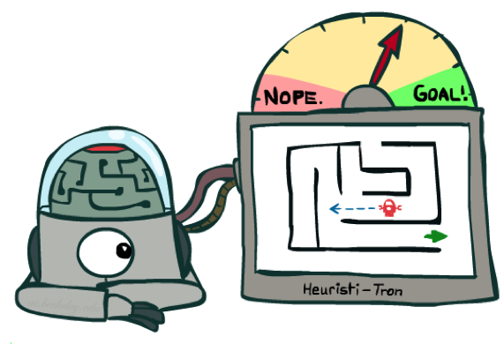
Heuristic Function
A heuristic is
  A function that estimates how close a state is to a goal
  Designed for a particular search problem
  Ex: Manhattan distance, Euclidean distance for pathing
10
5
11.2

Slide 38
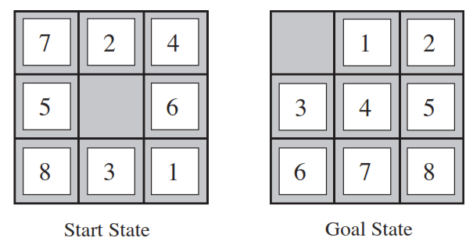
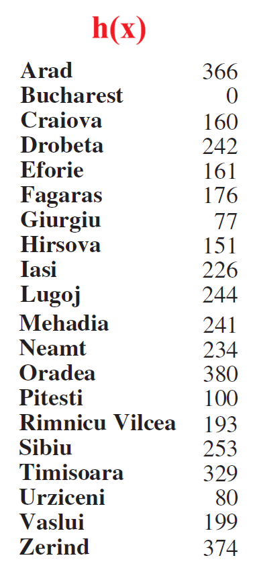
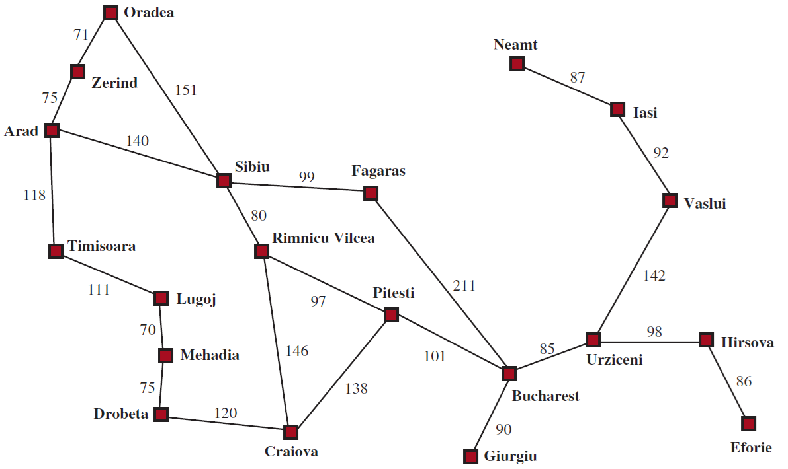
Heuristic Function
h(x) = the number of misplaced tiles (8)
  h(x) = the sum of the distances of the tiles from their goal positions (3+1+2+2+2+3+3+2 = 18)

Slide 39
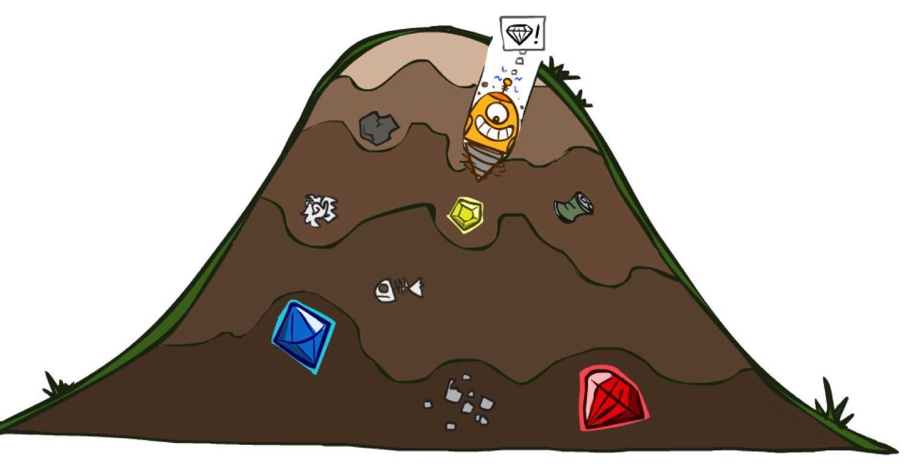
Greedy Best-First Search

Slide 40
Greedy Best-First Search
Strategy: expand a node that (you think) is closest to a goal state
  Heuristic: estimate of distance to nearest goal
  for each state
A common case:
  Best-first takes you straight to the (wrong) goal
Worst-case: heuristic wrong!!!
b
…
b
…

Slide 41
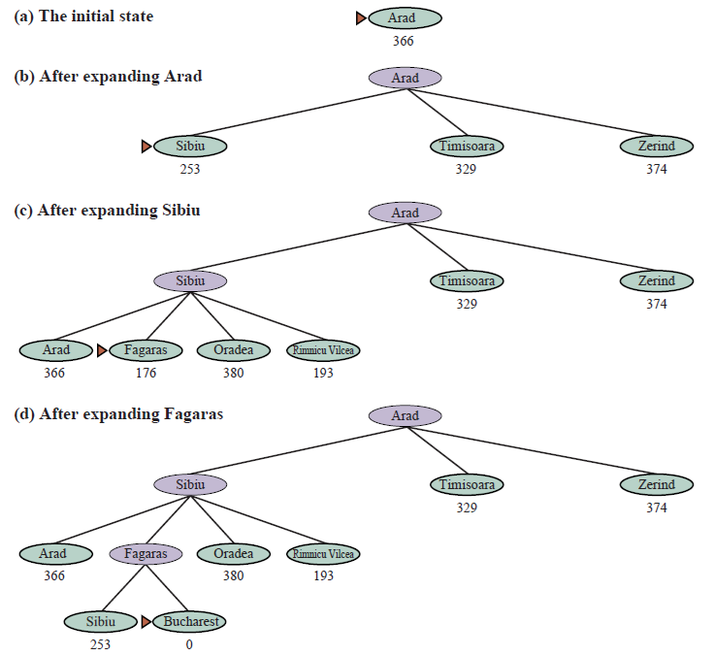
Greedy Best-First Search
We use the straight-line distance heuristic

Slide 42
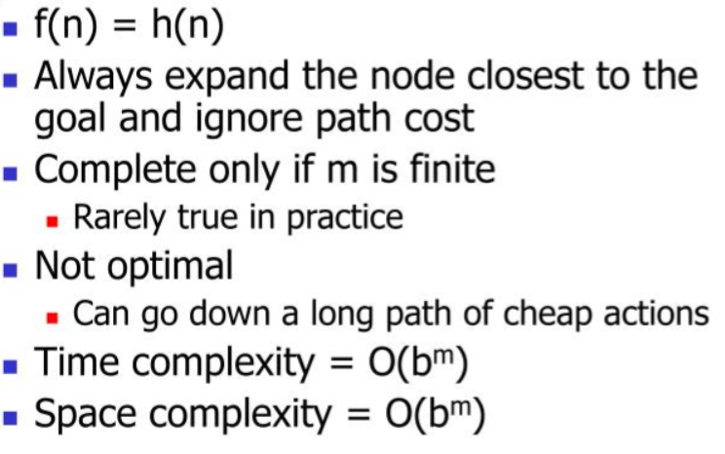
Greedy Best-First Search

Slide 43
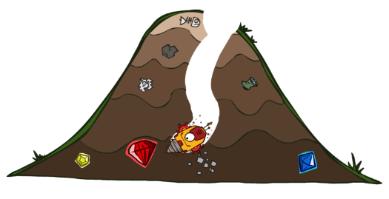
A* Search

Slide 44
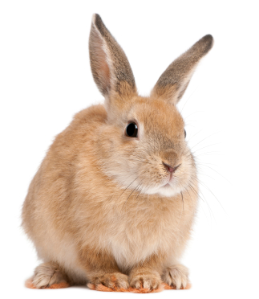
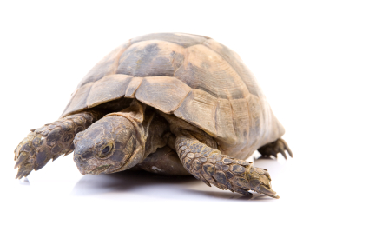

A* Search
Idea: Combining UCS and Greedy Best-First Search
Uniform-Cost orders by path cost, or backward cost: g(n)
Greedy Best-First Search orders by goal proximity, or forward cost: h(n)
A* Search orders by the sum: f(n) = g(n) + h(n).
UCS
Greedy
A*

Slide 45
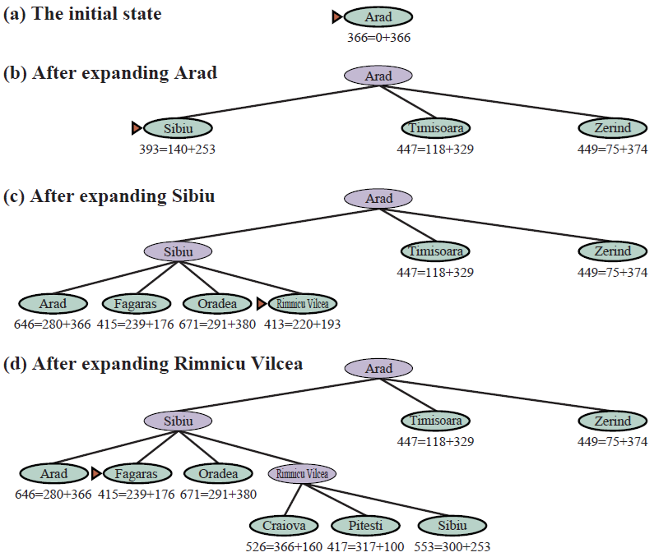
A* Search

Slide 46
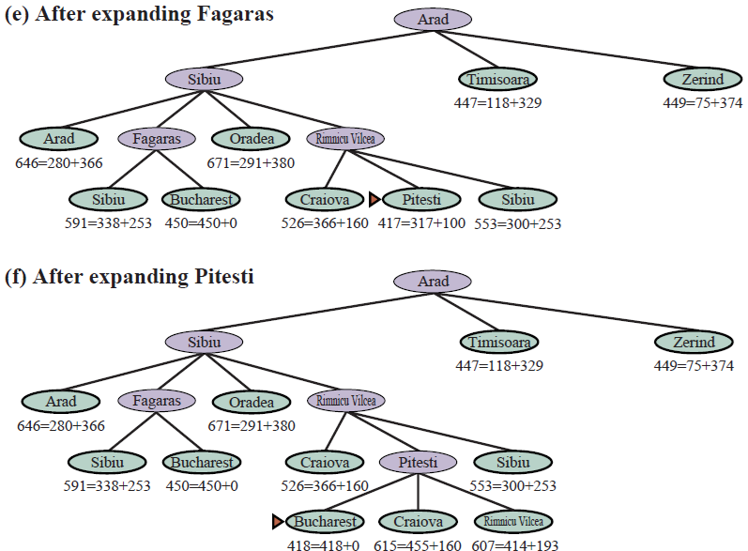
A* Search

Slide 47
A* Search
Uniform-cost orders by path cost, or backward cost g(n)
Greedy orders by goal proximity, or forward cost h(n)
A* Search orders by the sum: f(n) = g(n) + h(n)
>> Đường đi ngắn nhất: S – a – d - G
8
g = 0 h=6
S
e
h=1
g = 1 h=5
a
1
S
1
3
2
g = 2 h=6
g = 9 h=1
a
d
G
b
d
g = 4 h=2
e
h=6
1
h=5
h=2
h=0
1
g = 3 h=7
g = 6 h=0
g = 10 h=2
c
b
c
G
d
h=7
h=6
g = 12 h=0
G

Slide 48
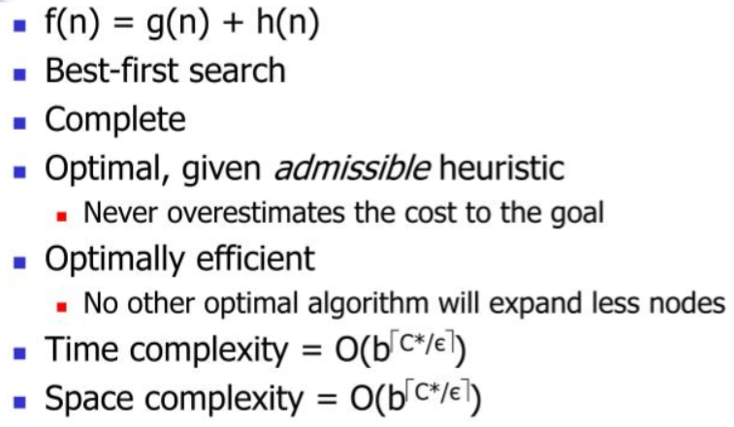
A* Search

Slide 49

SUMMARY
Search Problems
Uninformed Search
Informed Search

